Slide 1

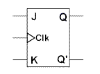
: 8
Lecture: 12
SR & JK Flip Flop

Slide 2
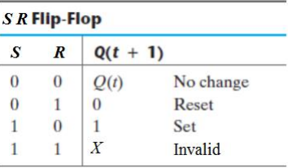
Characteristic Table
  specifies the next state when the inputs and the present states are known.

Slide 3
Characteristic Equation
Defines the next state of the flip-flop as a Boolean equation of the flip-flop inputs and the current state.
  Characteristic equation for SR flip flop is:
Q(t+1) = S+R`Q(t)

Slide 4
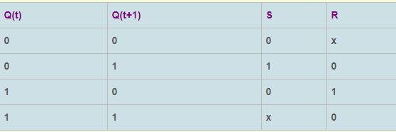
Excitation Table
Defines the flip-flop input variable values as function of the current state and the next state

Slide 5
SR Flip Flop
Also known as gated or clocked SR latch.
the output is changed (i.e. the stored data is changed) only when you give an active clock signal otherwise even if the S or R is active the data will not change.

Slide 6
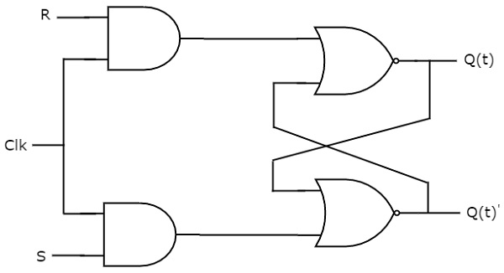
SR Flip Flop

Slide 7
Characteristic Table for SR Flip Flop

Slide 8
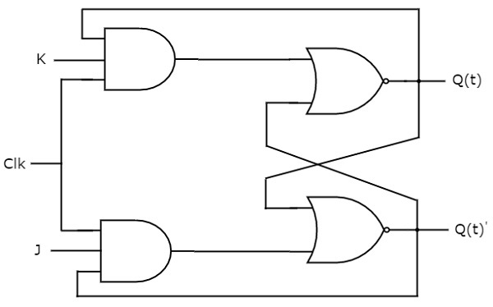
JK Flip Flop
  an improvement on the SR flip flop where S=R=1 is not a problem.
basically an SR flip flop with feedback

Slide 9
JK Flip Flop
  When both J & K inputs are at logic level ‘1’ at the same time and the clock input is pulsed high the circuit will toggle from its SET state to a RESET state or vice-versa.
  In a JK flip flop, toggle means change the output to the opposite state.

Slide 10
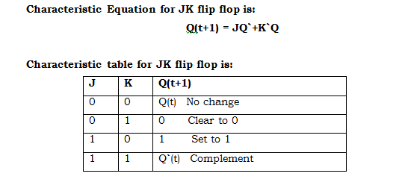
JK Flip Flop

Slide 11
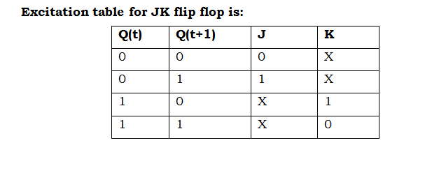
JK Flip Flop

